Slide 1
Titles of articles or chapters on books are always in
“quotation marks.”

Slide 2
Titles of books or works of art are always
italicized.

Slide 3
Quotations within the text must fit grammatically
as well as
fit logically with your writing.
Punctuation, verb tense, etc. must be consistent.

Slide 4
Quotations within the text must always cite
a page number.

Slide 5
Within quotations, ellipses (. . .) are ONLY used
if something from the middle of the quote
has been removed.
Do not begin and end quotations with . . .

Slide 6
BEWARE OF MALAPROPISMS

Slide 7
BEWARE OF MALAPROPISMS
noun: malapropism the mistaken use of a word in place of a similar-sounding one, often with unintentionally amusing effect, as in, for example, “dance a flamingo” (instead of flamenco ).

Slide 8
BEWARE OF PASSIVE VOICE

Slide 9
BEWARE OF PASSIVE VOICE
Passive voice sentences mention the thing or person receiving an action before mentioning the action itself, and may omit the actor altogether.

Slide 10
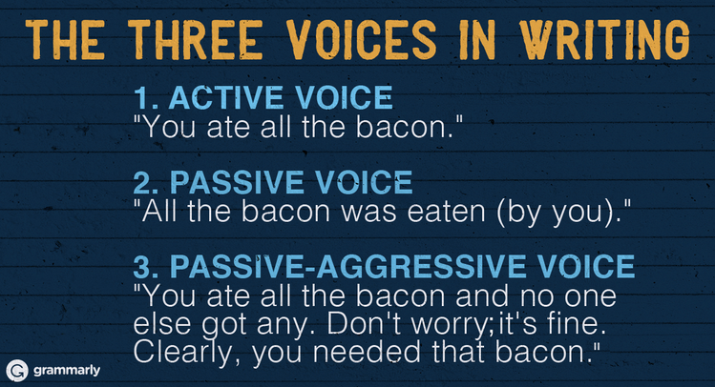
http://www.grammarly.com/blog/2015/how-to-use-the-passive-voice-correctly-2/

Slide 11
Make sure each sentence has a clear
subject and verb.

Slide 12
I am very serious about this. . . . .
Make sure each sentence has a clear
subject and verb.

Slide 13
Be concise. . .
Using more words does not make you
sound smarter.

Slide 14
Common editorial notations
WC - questionable word choice/ connotation does not match intended meaning or too casual or too cliched
WW - wrong word
SP - spelling
AWK - awkward/ sentence is wordy/ meaning unclear

Slide 15
Make this sentence better:
Upon the street which there was a ball that
being red had been kicked by a girl to such
a superfluous velocity that a window upon
the aforementioned street had been broken.

